Slide 1
Fortran Application (1)
Spatial data selection
Fourier Transform

Slide 2
Spherical to Cartesian coordinate system
subroutine delaz(elat,elon,slat,slon,dx,dy,delta)
Delta=sqrt(dx*dx+dy*dy)
Under codes\cdis.for

Slide 3
Fortran code
subroutine delaz(elat,elon,slat,slon,dx,dy,delta)
avlat=0.5*(elat+slat)
a=1.840708+avlat*(.0015269+avlat*(-.00034+avlat*(1.02337e-6)))
b=1.843404+avlat*(-6.93799e-5+avlat*(8.79993e-6+avlat*(-6.47527e-8)))
dlat=slat-elat
dlon=slon-elon
dx=a*dlon*60.
dy=b*dlat*60.
delta=sqrt(dx*dx+dy*dy)
return
end

Slide 4
Data project to a profile
Two points of projection (long1,lat1), (long2,lat2)
Select a original point all of the points change to km Cartesian coordinate.
Then, you got (x1,y1,delta), (x1,y1) vector, Delta → scalar
Then, you get another vector (x2,y2)

Slide 5
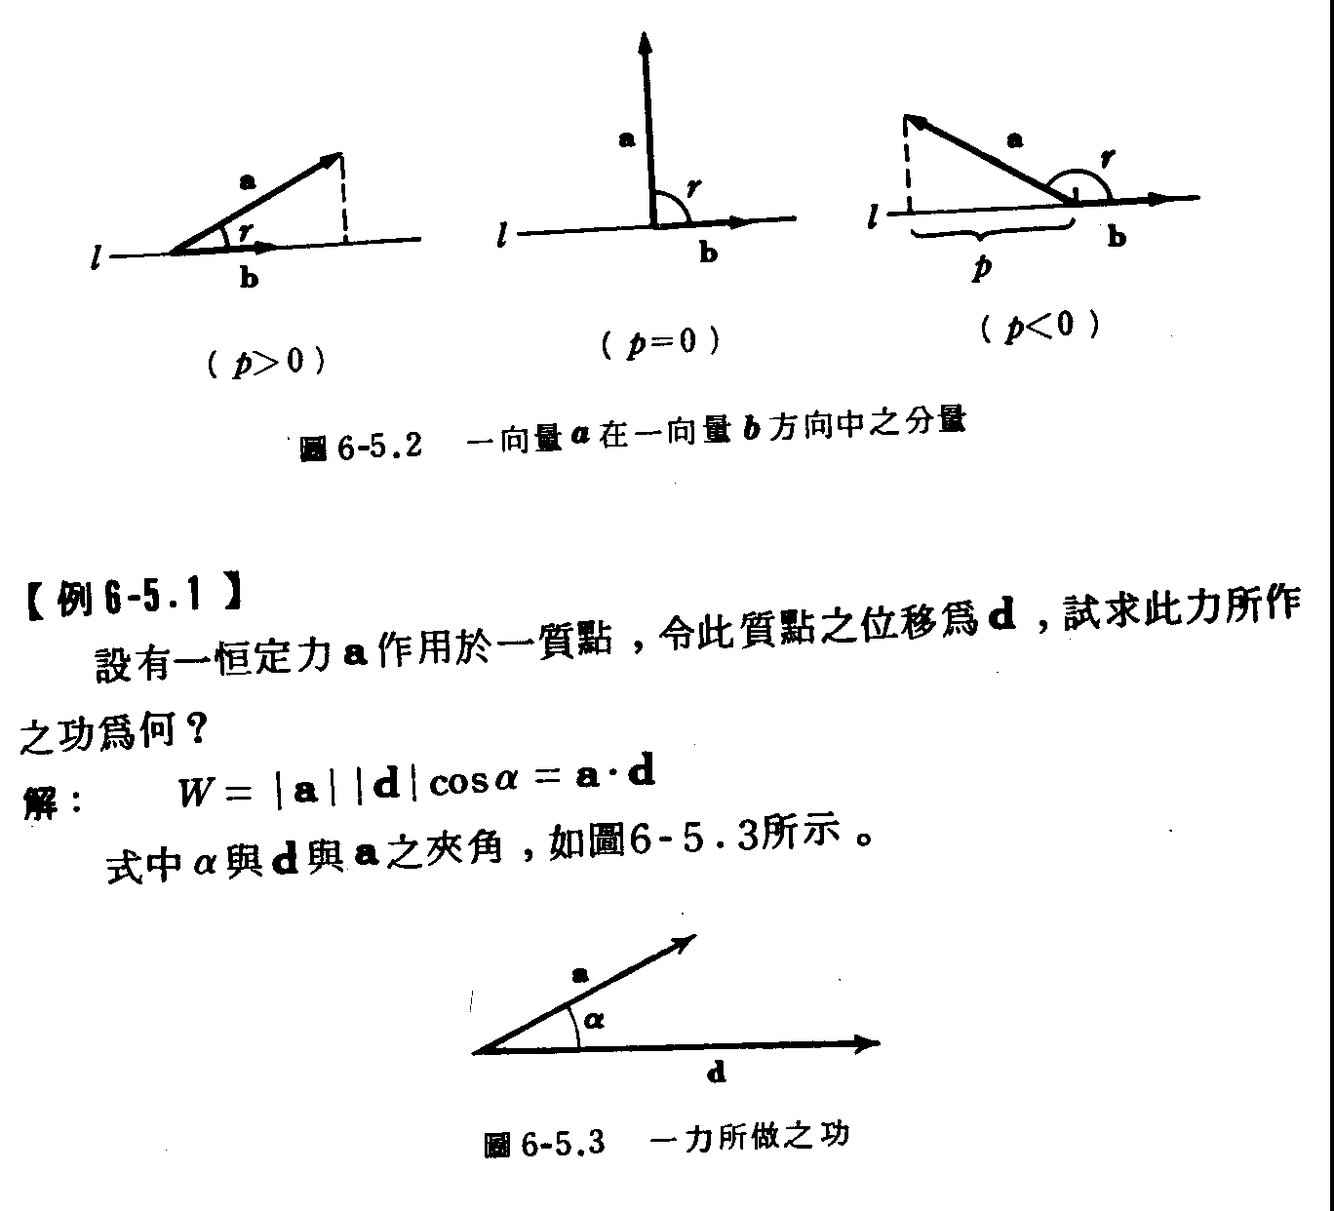

Slide 6
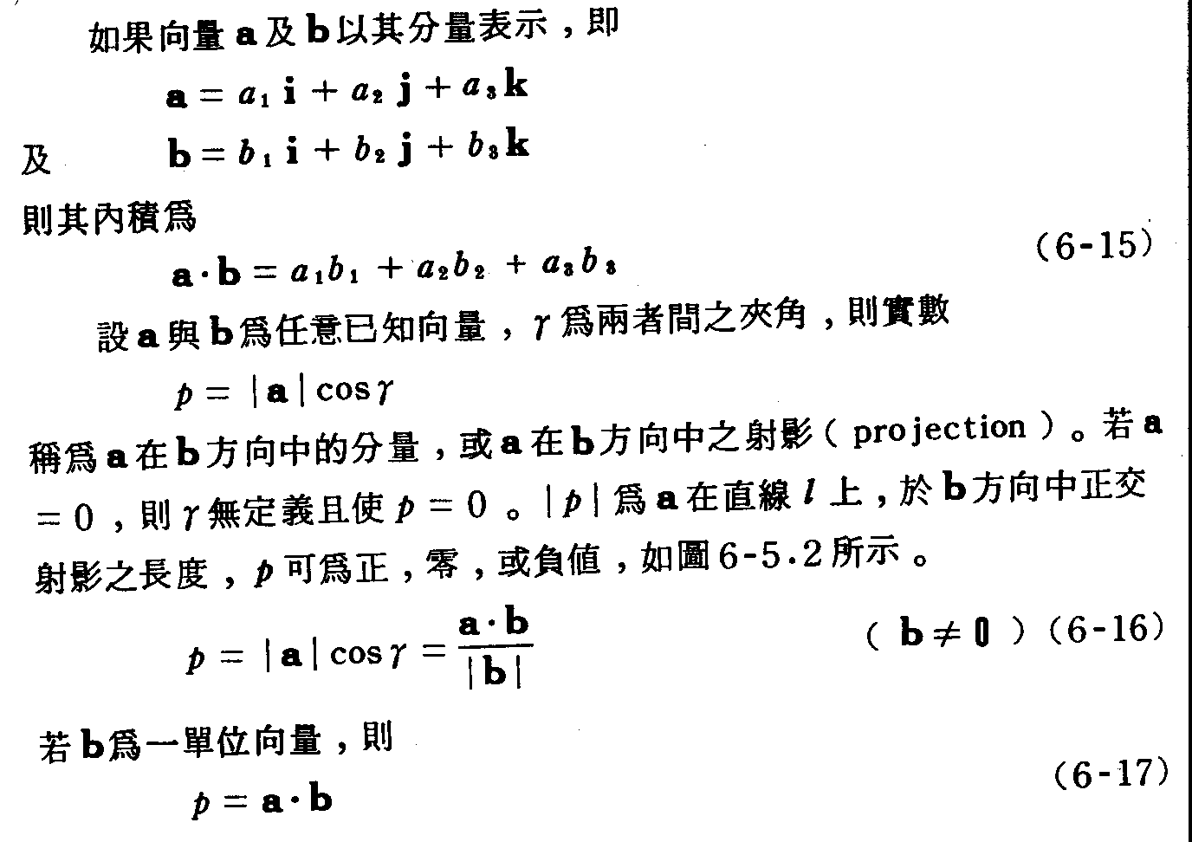

Slide 8
Homework 9-1
請將1999.lis中取出剖面(120.,23.) to (122.,25.0)離剖面50km內之地震，並繪出剖面圖。
Please read the earthquake coordinates from 1999.lis and project to the profile (120.,23.) to (122., 25.0) for the events within 50 km to the profile.

Slide 9
Fourier Transform

Slide 10
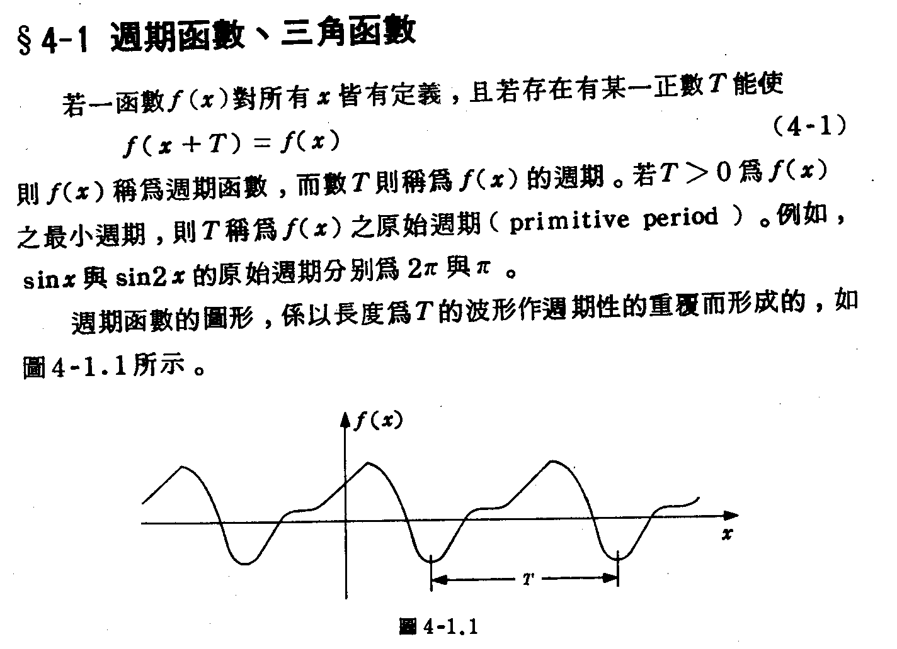

Slide 11
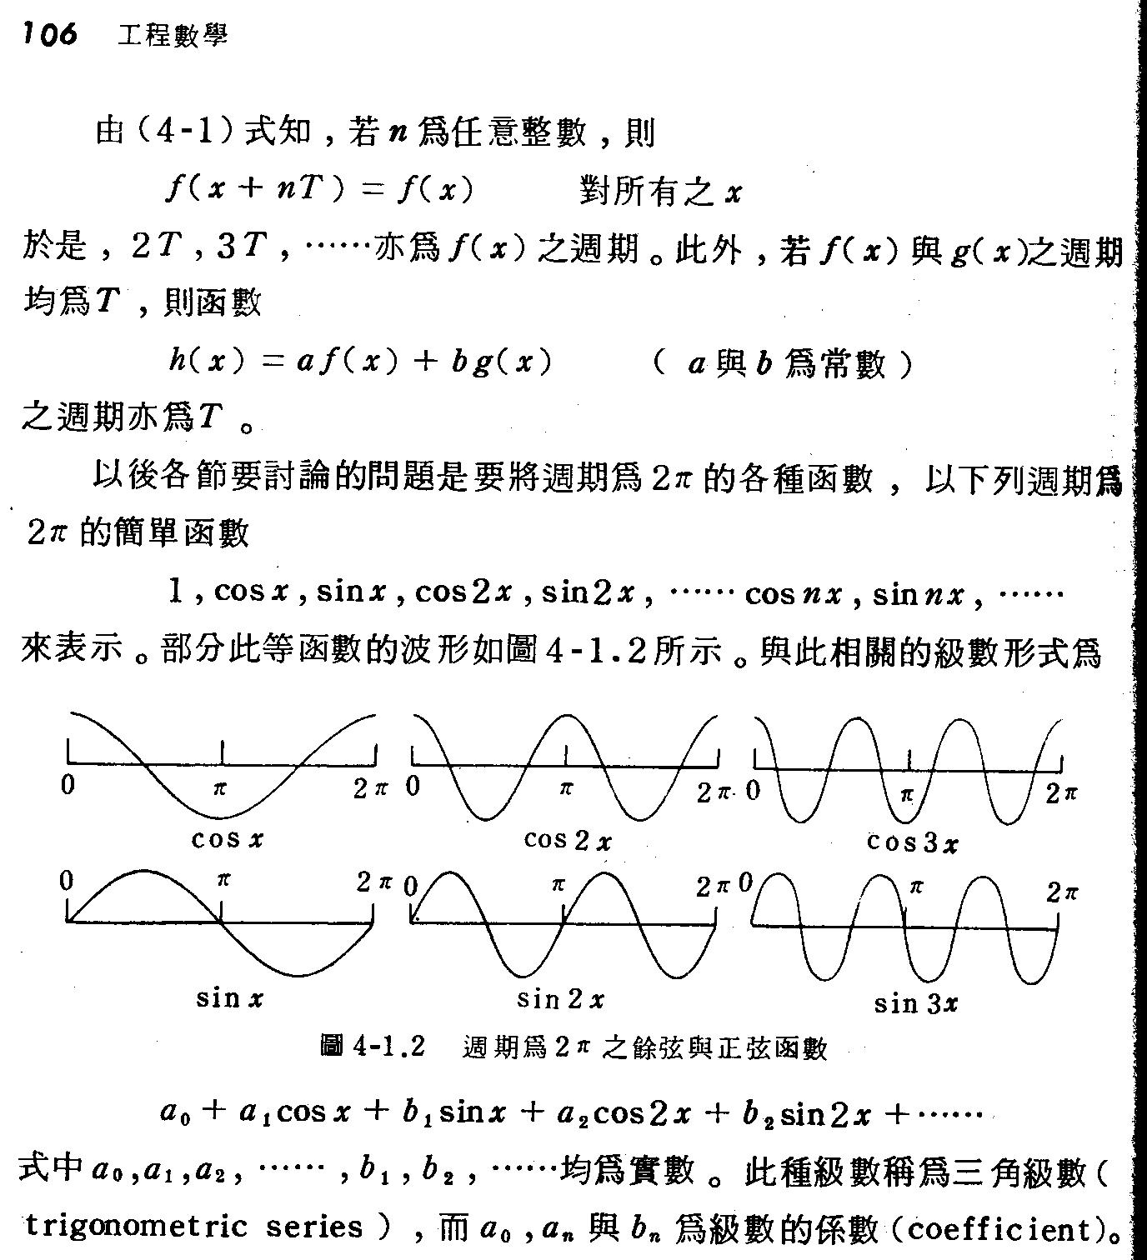

Slide 12
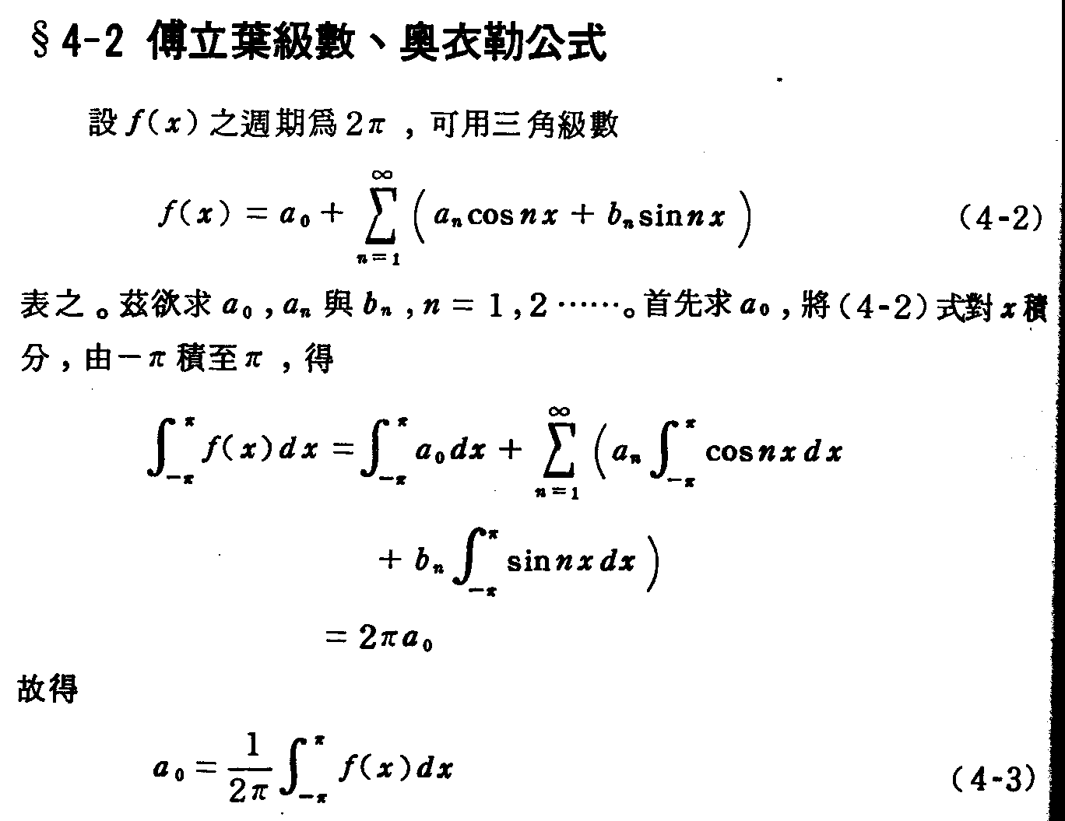

Slide 13
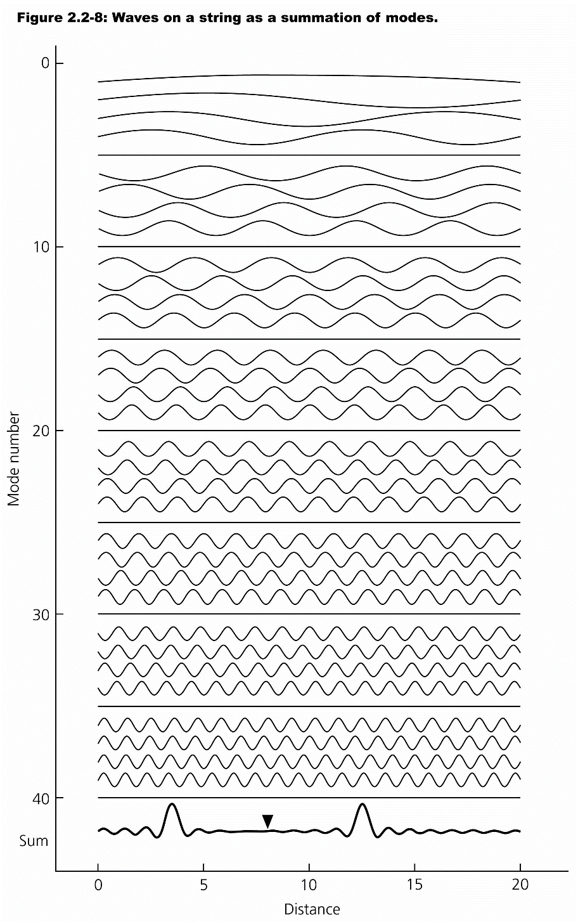
Fourier Transform converting
Time domain to
frequency domain

Slide 14
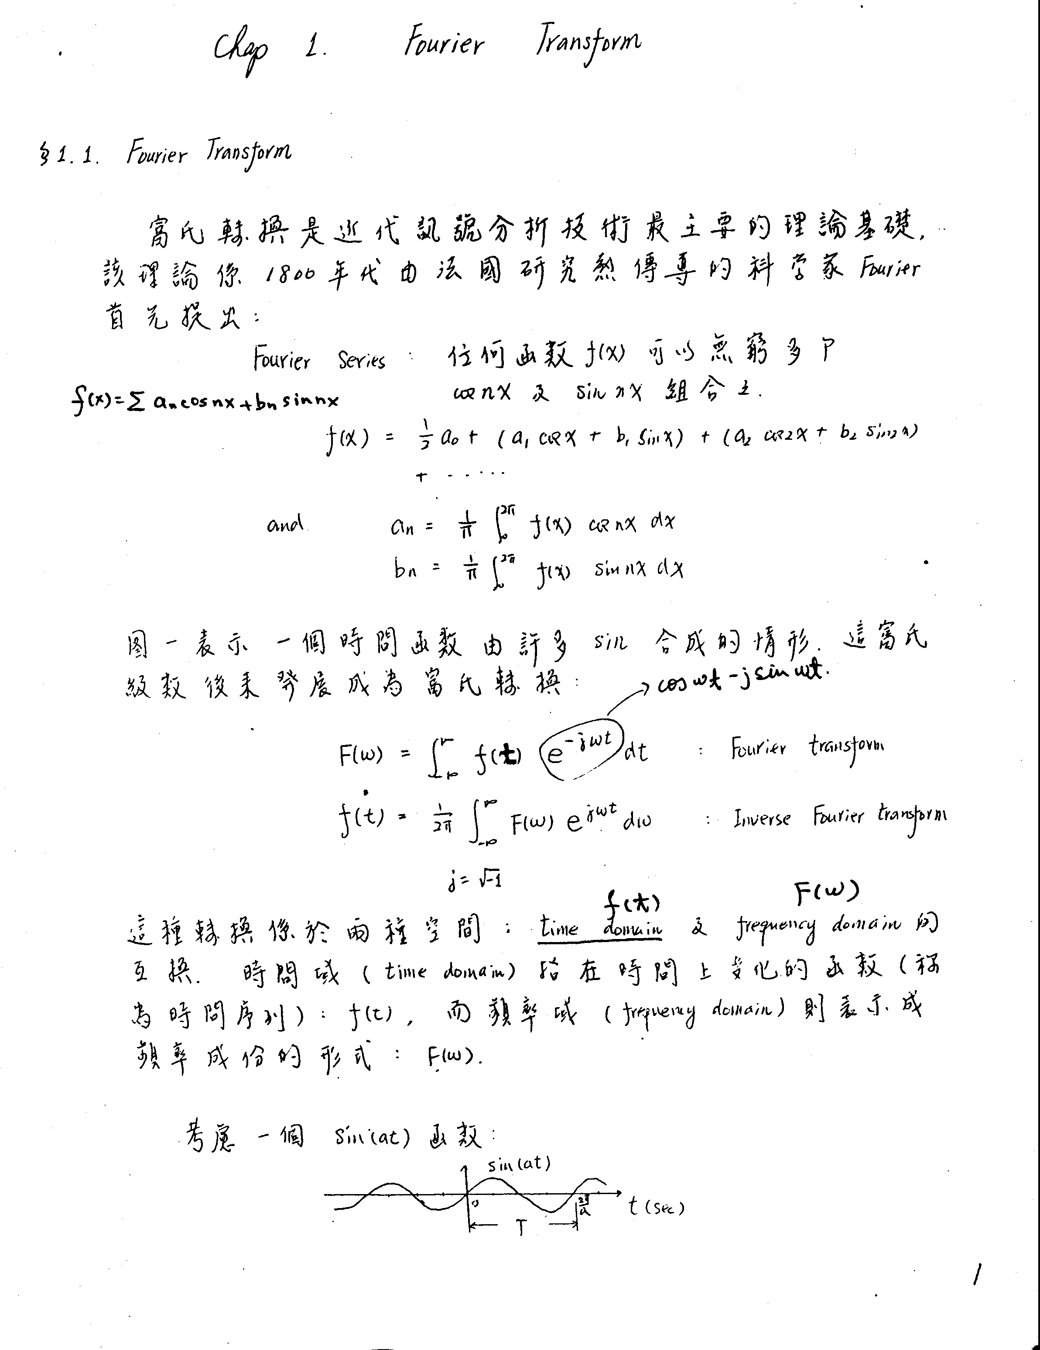

Slide 16
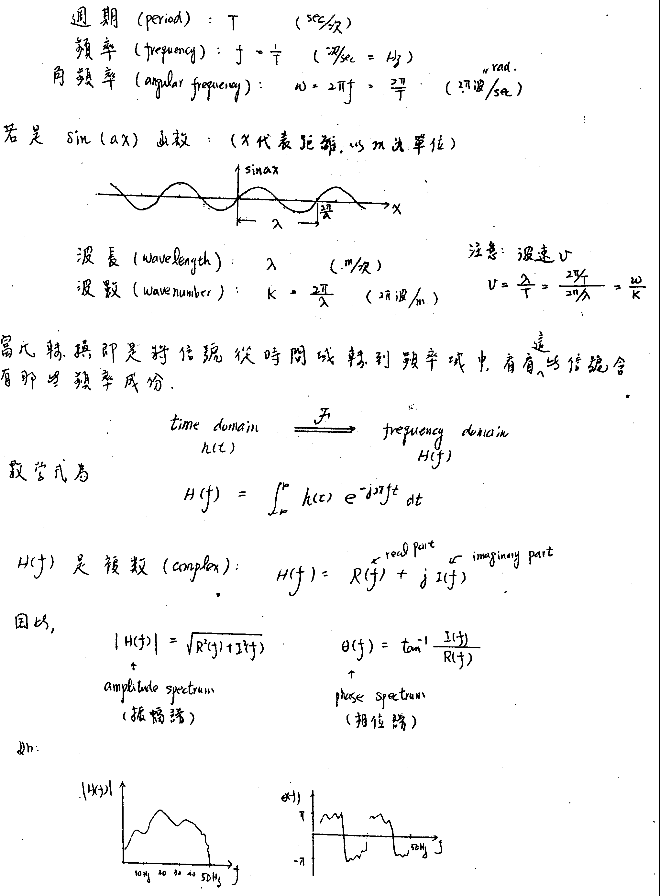

Slide 18
The Fast Fourier Transform
Need 2**N data point
Converting time series data to frequency domain.

Slide 19
FFT Fortran Code
SUBROUTINE FFT(XREAL,XIMAG,N,NU)
Real xreal(n),ximag(n)
Integer n→ 2^nu
Integer nu

Slide 20
Source code
SUBROUTINE FFT(XREAL,XIMAG,N,NU)
DIMENSION XREAL(N),XIMAG(N)
N2=N/2
NU1=NU-1
K=0
DO 100 L=1,NU
102 DO 101 I=1,N2
P=IBITR(K/2**NU1,NU)
ARG=6.283185*P/FLOAT(N)
C=COS(ARG)
S=SIN(ARG)
K1=K+1
K1N2=K1+N2
TREAL=XREAL(K1N2)*C+XIMAG(K1N2)*S
TIMAG=XIMAG(K1N2)*C-XREAL(K1N2)*S
XREAL(K1N2)=XREAL(K1)-TREAL
XIMAG(K1N2)=XIMAG(K1)-TIMAG
XREAL(K1)=XREAL(K1)+TREAL
XIMAG(K1)=XIMAG(K1)+TIMAG
101 K=K+1
K=K+N2
IF(K.LT.N) GOTO 102
K=0
NU1=NU1-1
100 N2=N2/2
DO 103 K=1,N
I=IBITR(K-1,NU)+1
IF(I.LE.K) GOTO 103
TREAL=XREAL(K)
TIMAG=XIMAG(K)
XREAL(K)=XREAL(I)
XIMAG(K)=XIMAG(I)
XREAL(I)=TREAL
XIMAG(I)=TIMAG
103 CONTINUE
RETURN
END
FUNCTION IBITR(J,NU)
J1=J
IBITR=0
DO 200 I=1,NU
J2=J1/2
IBITR=IBITR*2+(J1-2*J2)
200 J1=J2
RETURN
END

Slide 21
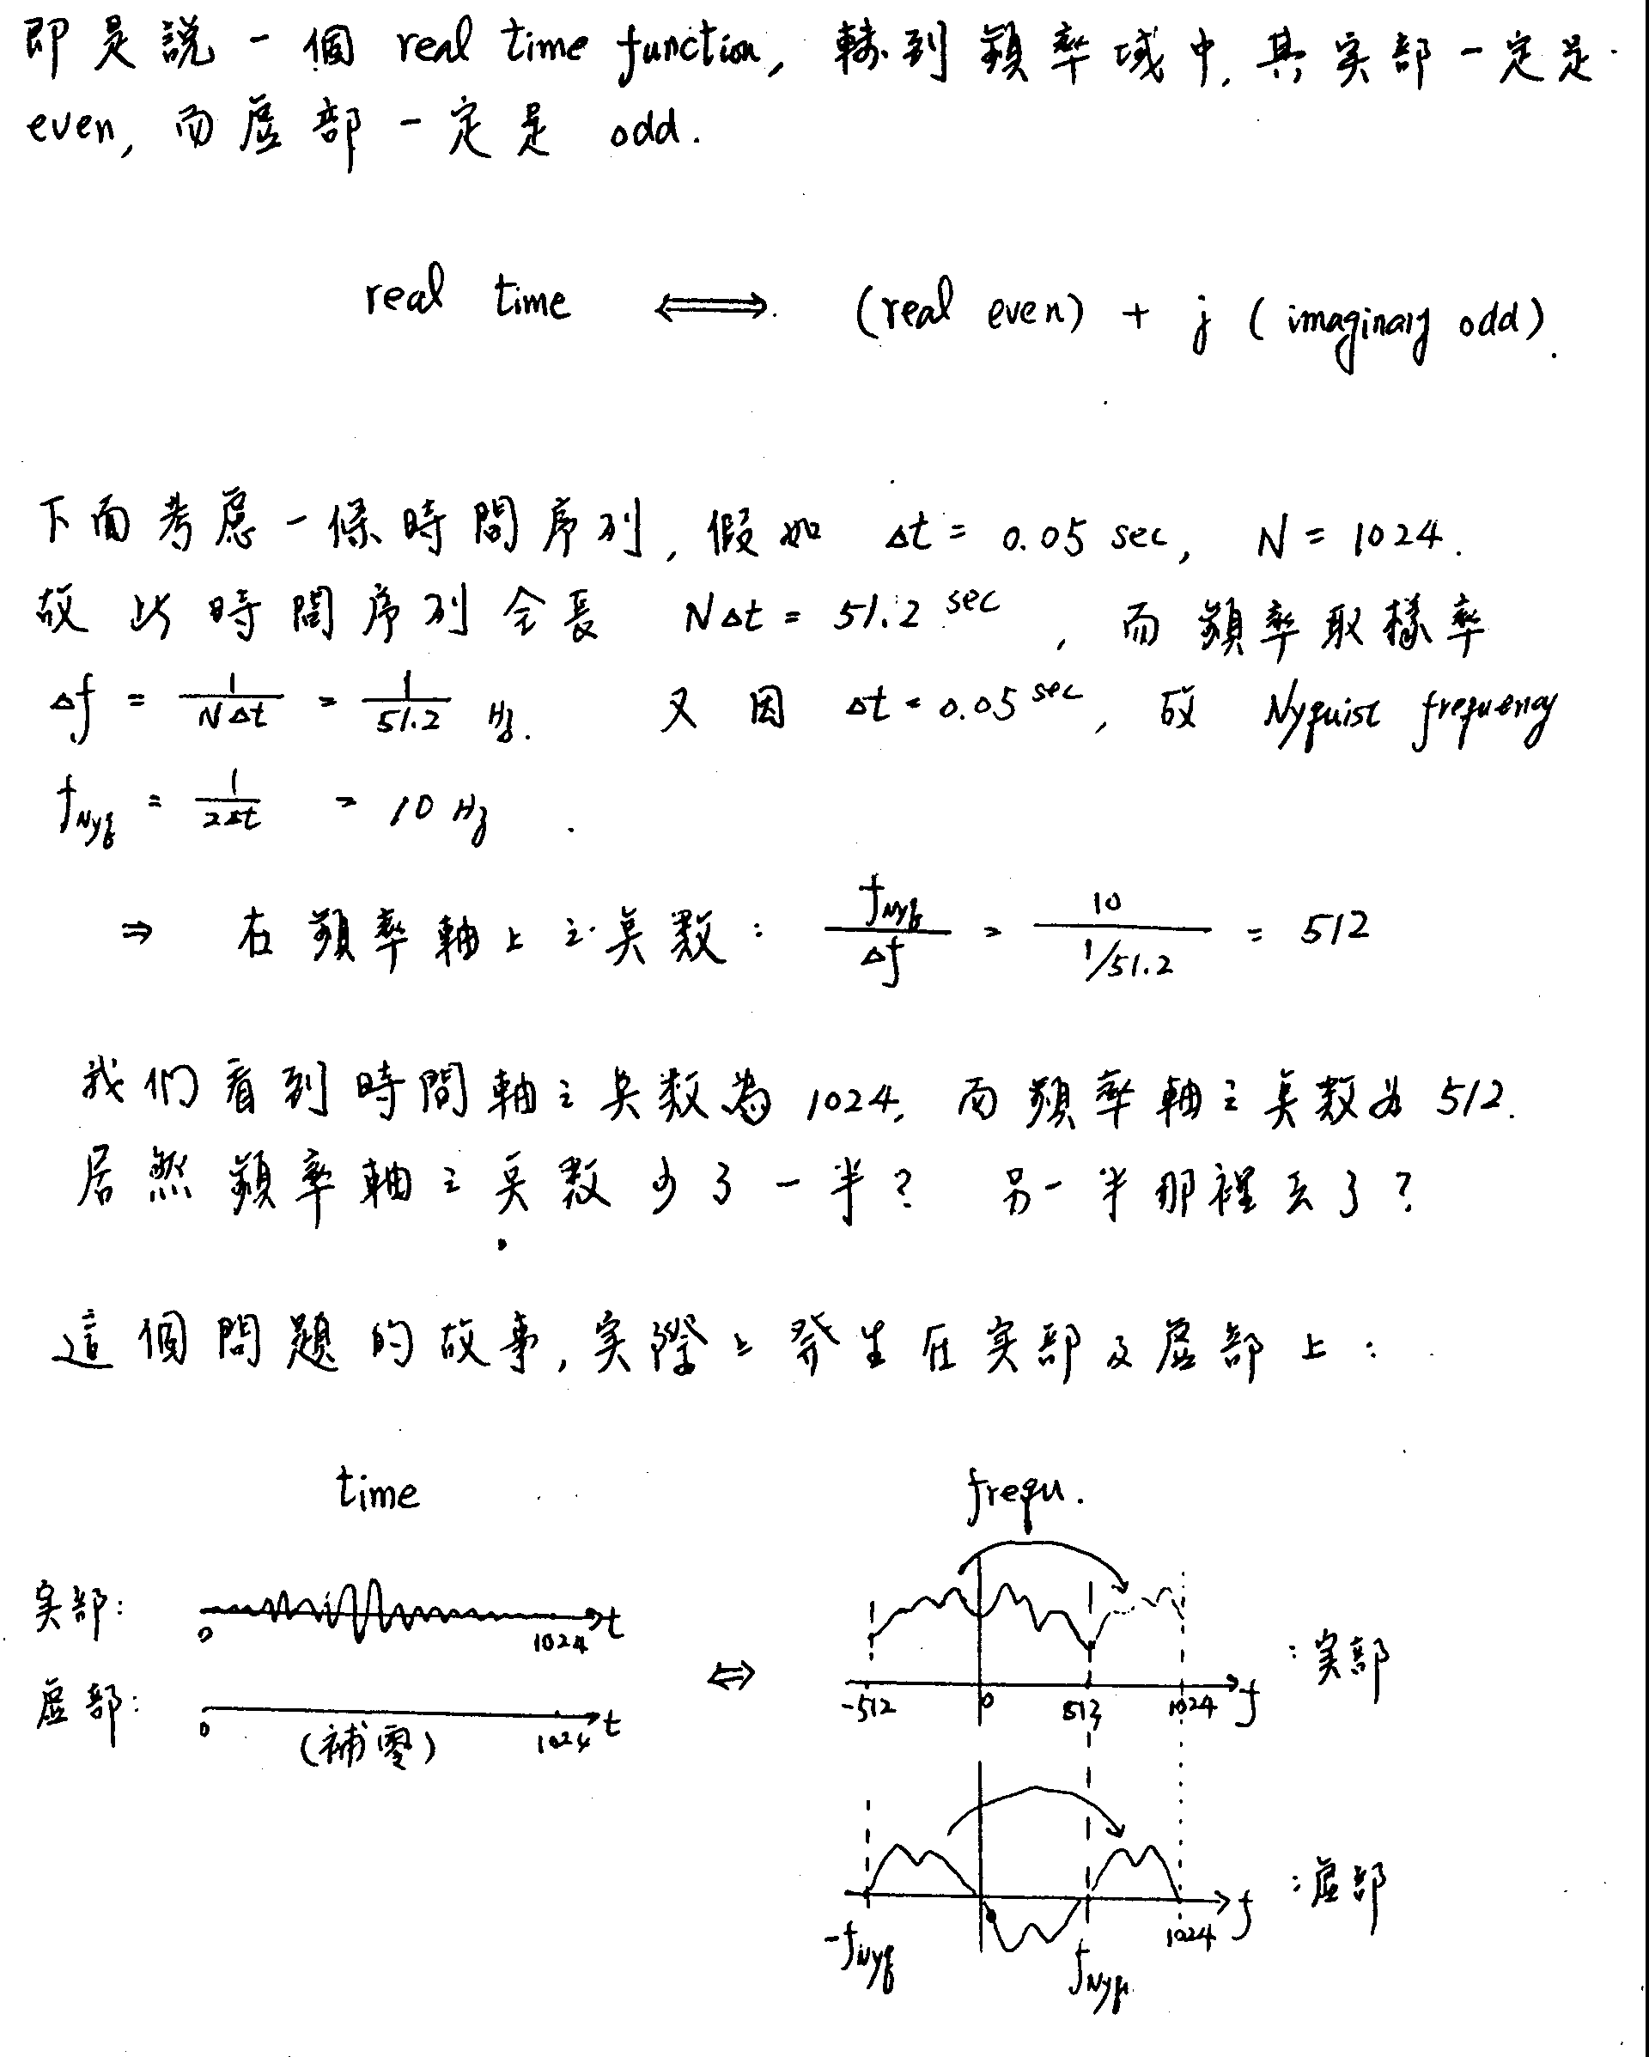

Slide 23
Homework 9-2
請將seismicdata.bin (binary file)地震波形讀出並使用FFT繪出頻譜。
Read the waveform from seismicdata.bin (binary file) and plots the Fourier amplitude spectrum.

